Slide 1
Investigating the impact of multicomponent interactions on solute transport via high-throughput experiments
Laurianne Estrada, Jonathan A. Ouimet, Zhicheng Lu, Molly Dougher, Shammah Lilonfe, Alexander W. Dowling, William A. Phillip
3.31.24

Slide 2

Publication journal target
Submit manuscript end of semester/early summer

Slide 3
Overarching questions
How is the transport of one ion influenced by the presence of competing ions (Na⁺, Ca²⁺ , La³⁺ )?
What adjustments to current models need to be made, if any?
What data sets are needed to validate current models?

Slide 4
Motivation
The streams we aim to treat have complex compositions.
For membranes to be implemented into processes, we need models that can predict what will be in the permeate.
Models must account for membrane properties (mechanistic insight) and span a range of concentration regimes (dilute to concentrated).

Slide 5
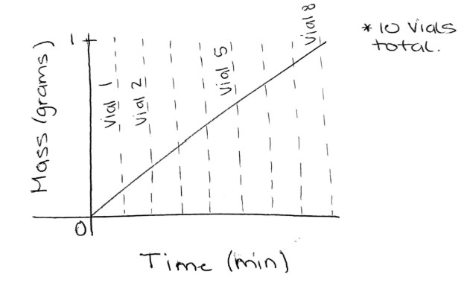
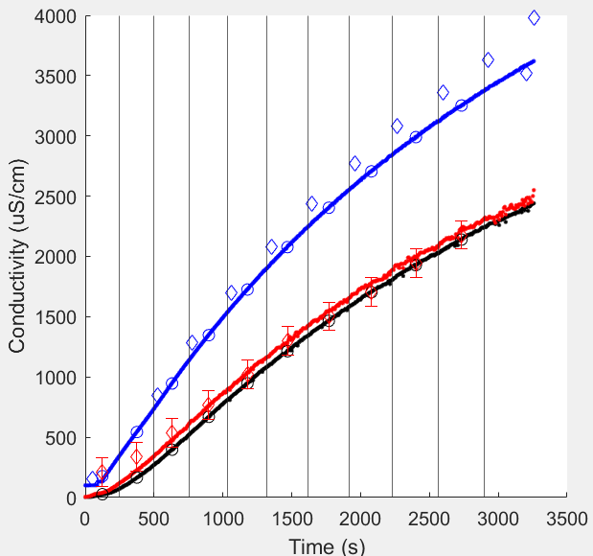
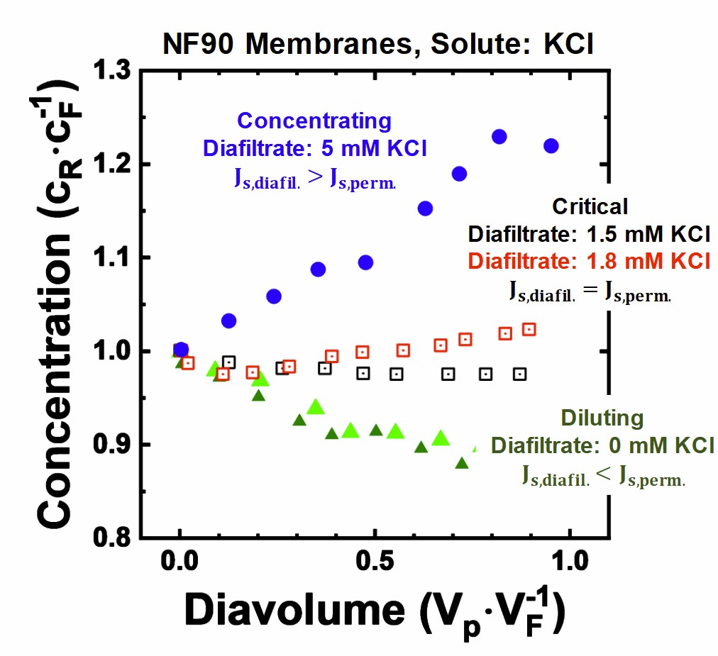
Figure 1: Experimental Data and Operating Regimes
NaCl – Single Component raw data
*Main text will show NaCl. SI plots can be made for CaCl₂ and LaCl₃ single salts.

Slide 6
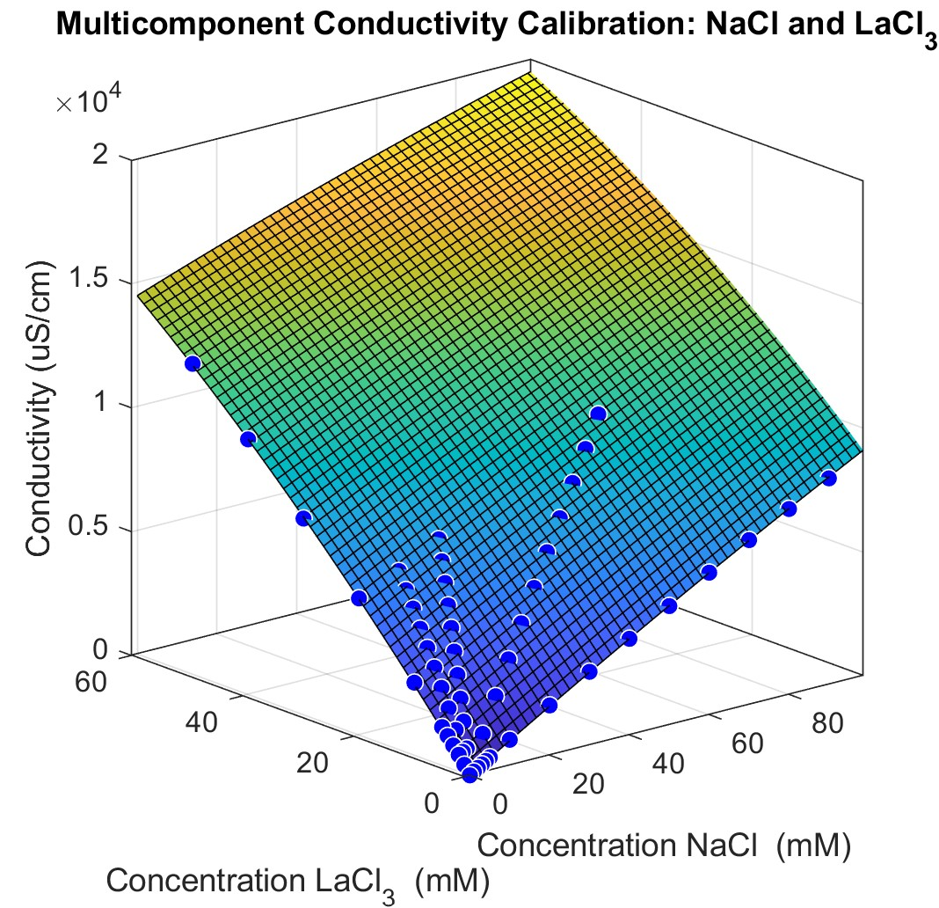
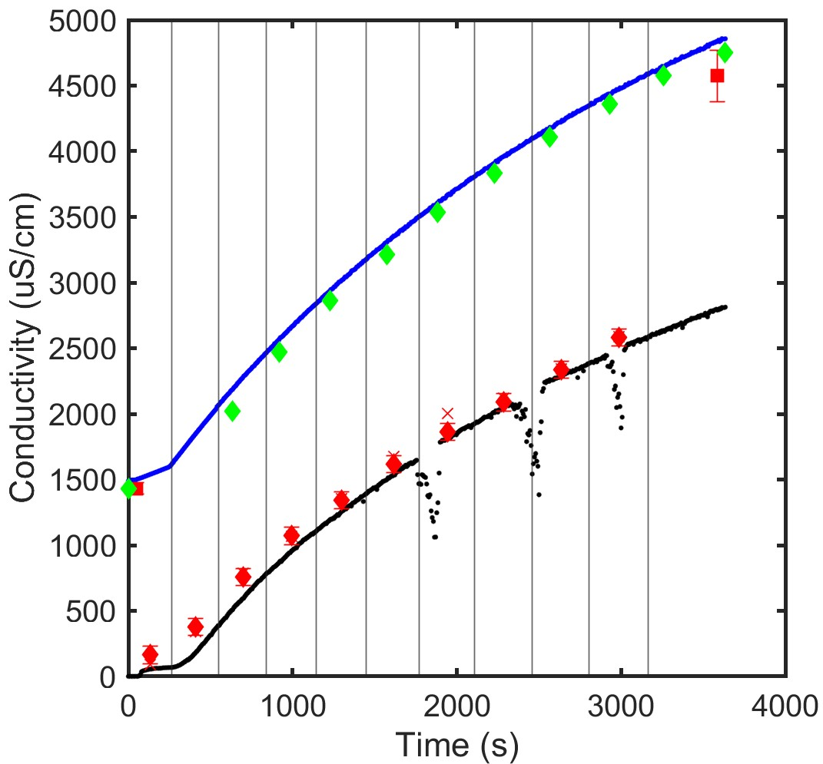
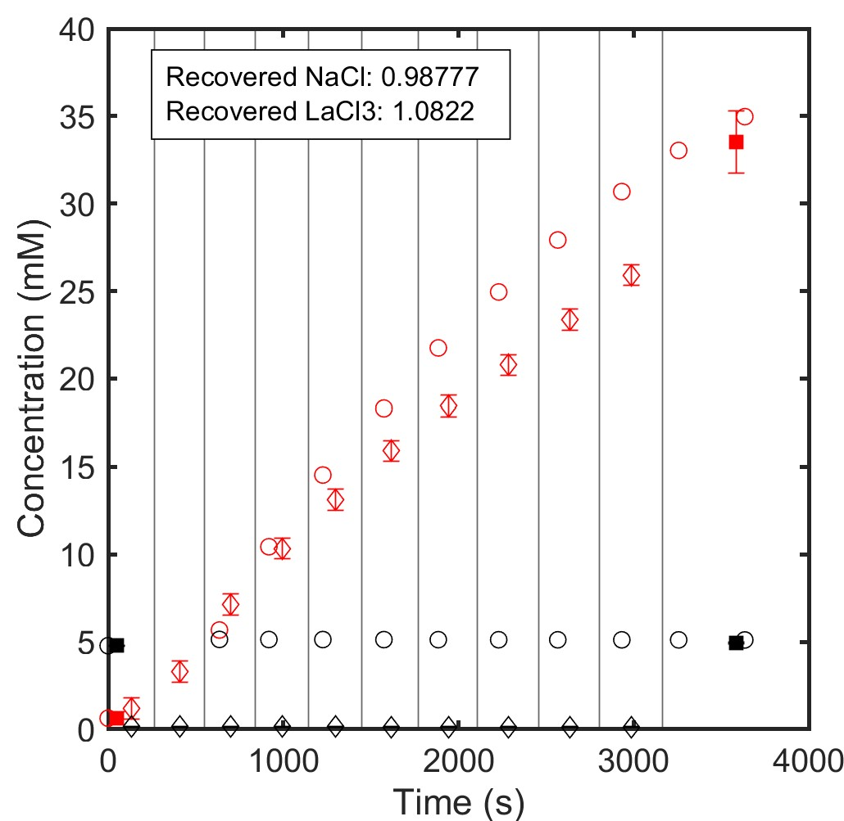
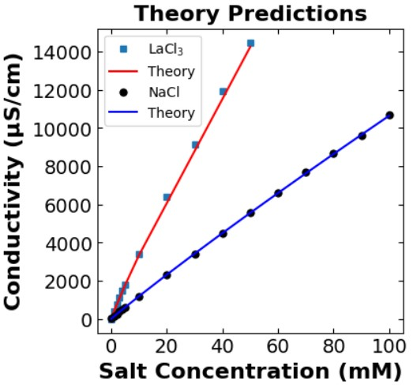
Figure 2: Conductivity to Concentration
NaCl + LaCl₃ multicomponent raw data
*Main text will show NaCl/LaCl₃. SI plots can be made for NaCl/CaCl₂ and CaCl₂/LaCl₃ multicomponent salts.
*Single salt calibration curve – compare experimental data points with theory (Shammah).

Slide 7
Figure 2: Conductivity to Concentration
NaCl + LaCl₃ multicomponent raw data
Permeability probe conductivity
Retentate probe conductivity
ICP feed and retentate
Bulk permeate conductivity
ICP permeate
Retentate mass balance
Feed/Retentate
Red – La³⁺
Black – Na⁺
Permeate
X
Mass Balance

Slide 8
Figure 3: Concentration phase space
Add a circle for the feed concentration (experiment start).
Add a star for the retentate concentration (experiment ends).
Triangles are retentate concentrations that correspond to each permeate vial (calculated from a mass balance using ICP).
*Main text will show NaCl/LaCl₃. SI plots can be made for NaCl/CaCl₂ and CaCl₂/LaCl₃.
*SI can include tables denoting what experiments “E1-E#” are.

Slide 9
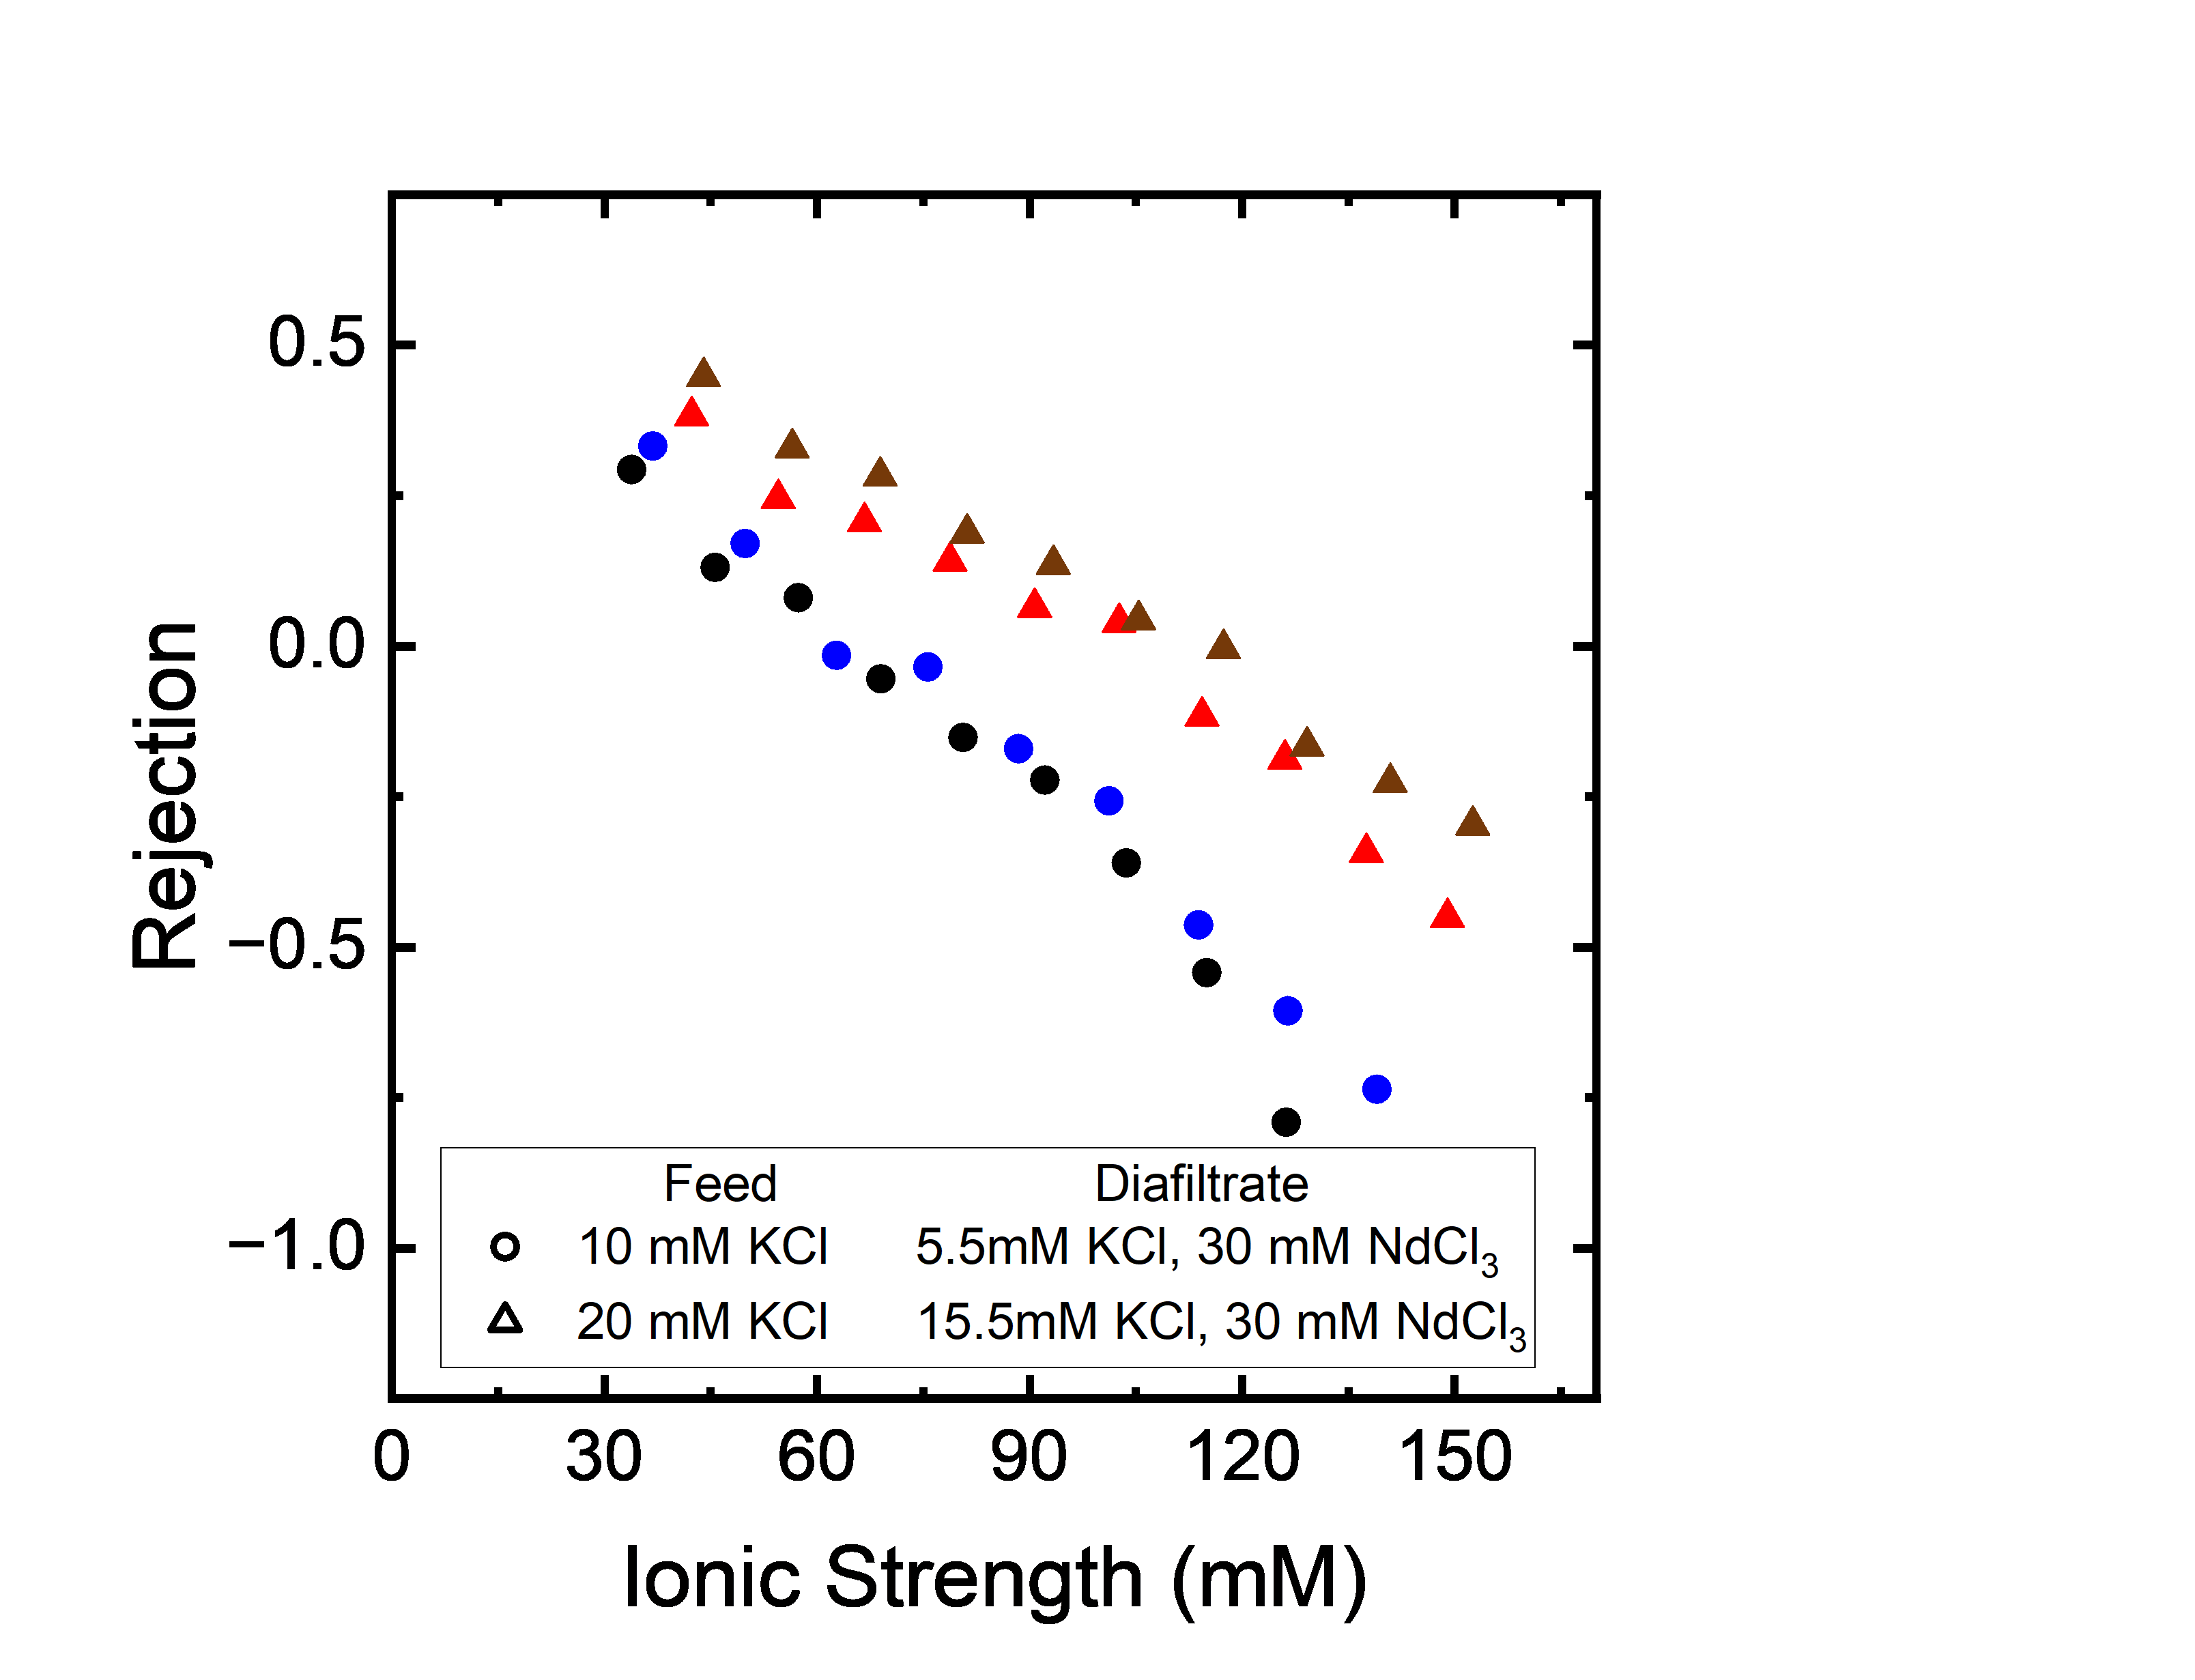
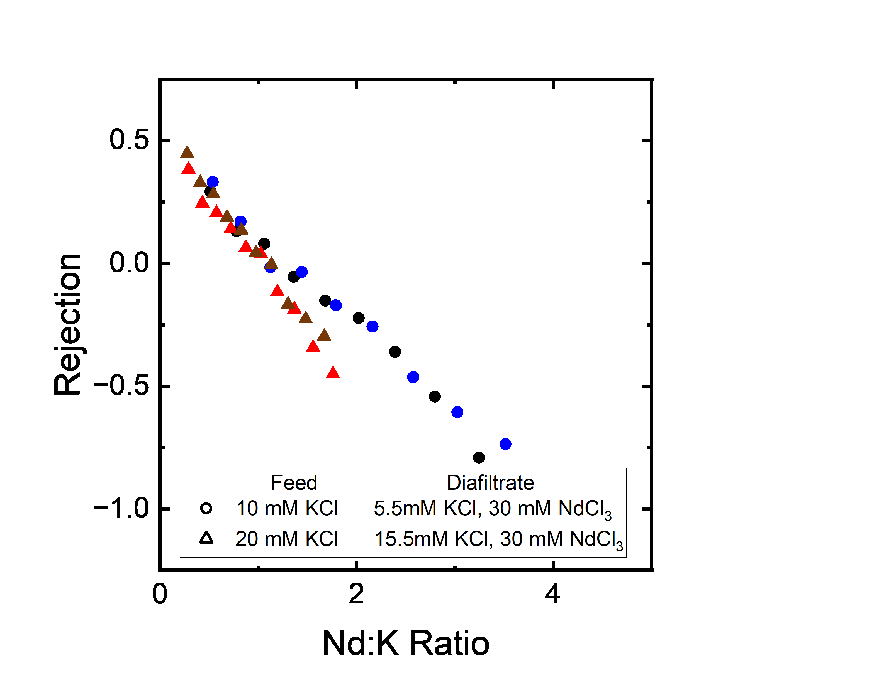
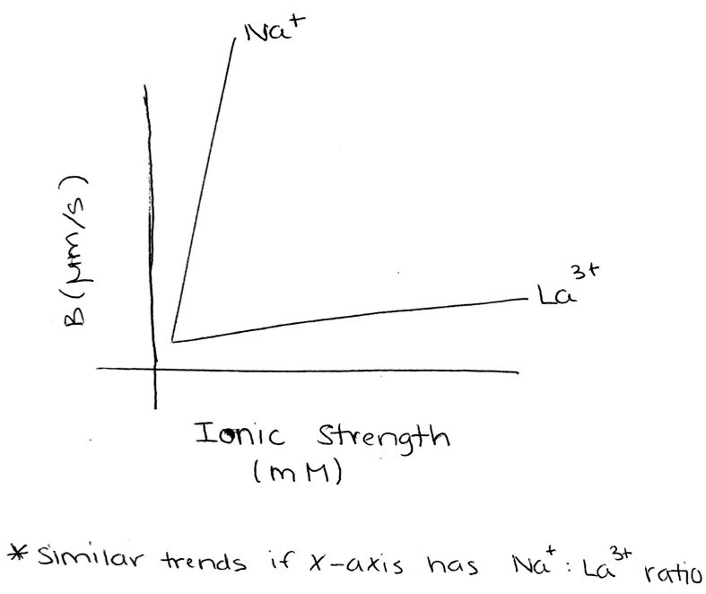
Figure 4: Membrane performance
*Main text will show NaCl/LaCl₃. SI plots can be made for NaCl/CaCl₂ and CaCl₂/LaCl₃.

Slide 10
Figure 4: Membrane performance
Plots have K⁺ (Na⁺ ) from rejection of KCl/NdCl3 experiment only. We will need to adjust these figures to have:
Single salt NaCl
Single salt LaCl₃
Constant NaCl increasing LaCl₃ at conc #1
Constant NaCl increasing LaCl₃ at conc #2
Increasing NaCl constant LaCl₃ at conc #1
Increasing NaCl constant LaCl₃ at conc #2

Slide 11
Figure 5: Three ion experiments
For now, we are waiting to see what these experiments look like.
Raw diafiltration data
Ion rejections
Selectivity
Material properties

